Slide 1
Saddle point example

Slide 2
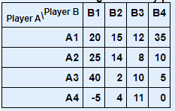
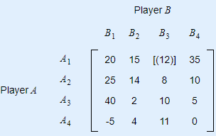


1. Find Solution of game theory problem using saddle point.
Solution:
We apply the maximin (minimax) principle to analyze the game.
Select minimum from the maximum of columns Column MiniMax = (12)
Select maximum from the minimum of rows Row MaxiMin = [12]
Here, Column MiniMax = Row MaxiMin = 12
∴ This game has a saddle point and value of the game is 12
The optimal strategies for both players are
The player A will always adopt strategy 1
The player B will always adopt strategy 3
https://cbom.atozmath.com/example/CBOM/GameTheory.aspx?he=e&q=saddlepoint

Slide 3
Dominance method example
dominance method Steps (Rule)
Step-1: | 1. If all the elements of Column-i are greater than or equal to the corresponding elements of any other Column-j, then the Column-i is dominated by the Column-j and it is removed from the matrix. eg. If Column-2 ≥ Column-4, then remove Column-2
Step-2: | 1. If all the elements of a Row-i are less than or equal to the corresponding elements of any other Row-j, then the Row-i is dominated by the Row-j and it is removed from the matrix. eg. If Row-3 ≤ Row-4, then remove Row-3
Step-3: | Again repeat Step-1 & Step-2, if any Row or Column is dominated, otherwise stop the procedure.

Slide 4
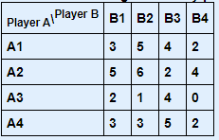
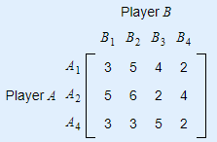
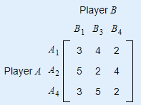
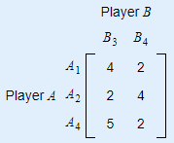
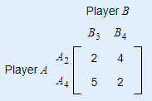
1. Find Solution of game theory problem using dominance method
Solution:
Dominance rule to reduce the size of the payoff matrix Using dominance property
Row-3 ≤ Row-4, so remove Row-3
Column-2 ≥ Column-4, so remove Column-2
Column-1 ≥ Column-3, so remove Column-1
Row-1 ≤ Row-3, so remove Row-1

